Slide 1
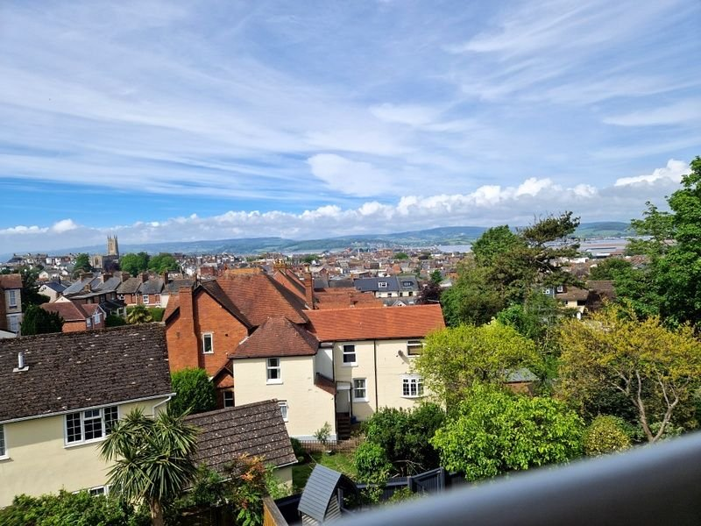
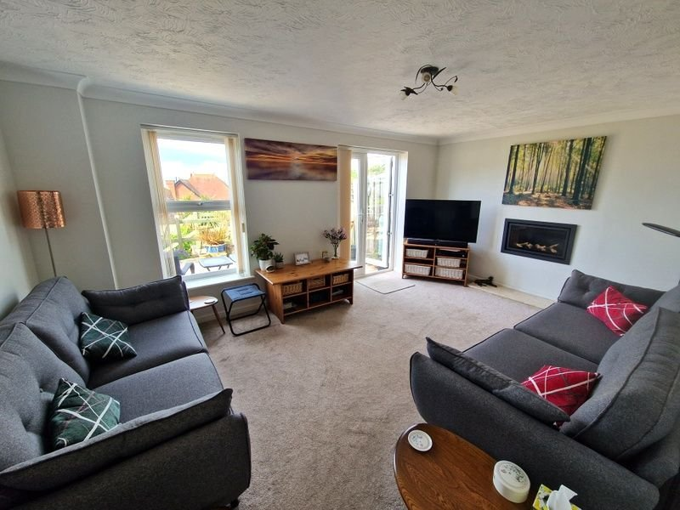
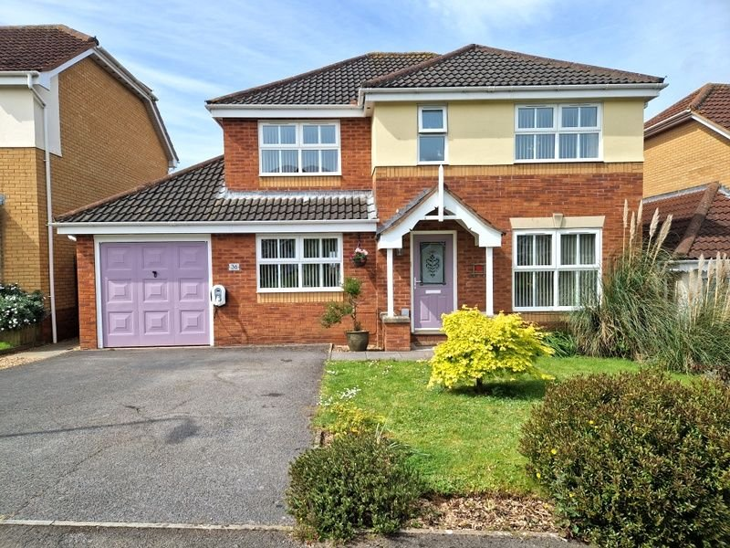
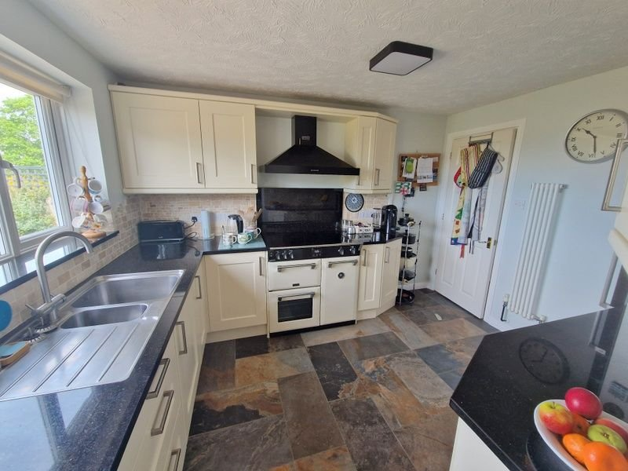
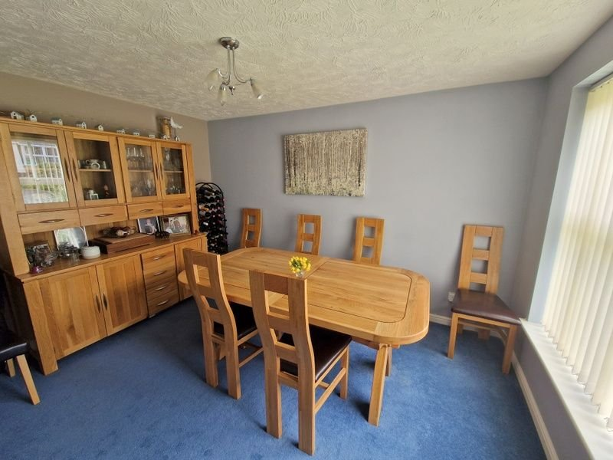
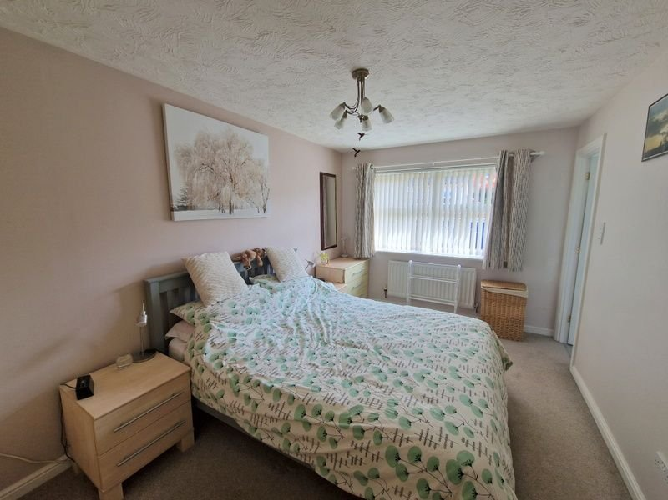
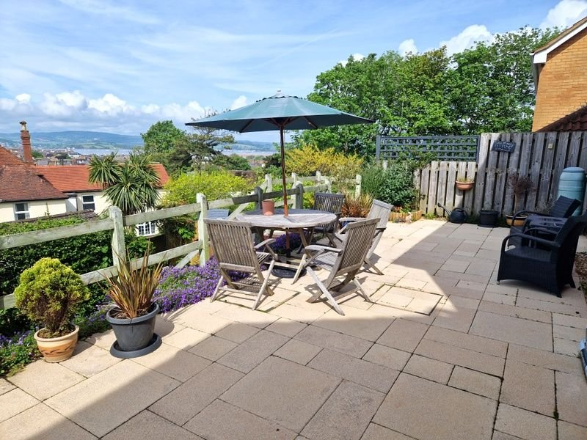
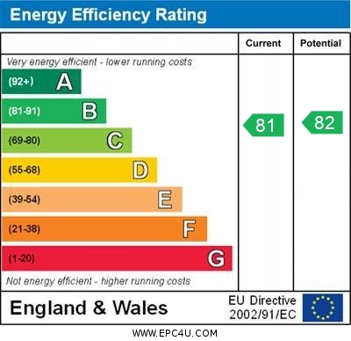
www.pennys.net
36 Regents Gate, Exmouth, EX8 1TR
GUIDE PRICE £625,000
TENURE Freehold
A Beautifully Presented Detached House Forming Part Of A Select Development With Excellent Estuary And Coastline Views, Southerly Aspect Facing Garden.
Gas Central Heating • Double Glazed Windows • Owned Solar Panels •
Lounge And Separate Dining Room • Study •
Modern Kitchen And Utility Room • Cloakroom/WC •
Four Bedrooms - En-Suite Refitted Shower Room/WC • Double Width Driveway •
Viewing Recommended •
Pennys Estate Agents Limited for themselves and for the vendor of this property whose agents they are give notice that:- (1) These particulars do not constitute any part of an offer or a contract. (2) All statements contained in these particulars are made without responsibility on the part of Pennys Estate Agents Limited. (3) None of the statements contained in these particulars are to be relied upon as a statement or representation of fact. (4) Any intending purchaser must satisfy himself/herself by inspection or otherwise as to the correctness of each of the statements contained in these particulars. (5) The vendor does not make or give and neither do Pennys Estate Agents Limited nor any person in their employment has any authority to make or give any representation or warranty whatever in relation to this property.
PENNYS ESTATE AGENTS
2 Rolle House, Rolle Street, Exmouth, Devon, EX8 2SN
Tel: 01395 264111 EMail: help@pennys.net

Slide 2
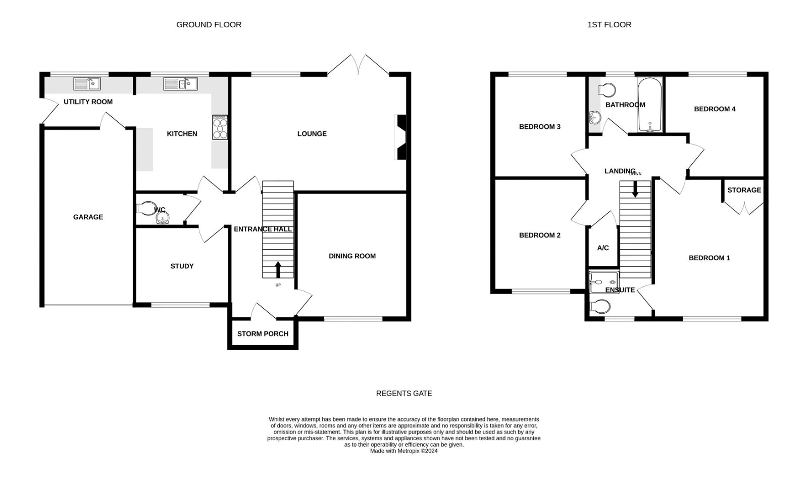
36 Regents Gate, Exmouth, EX8 1TR
THE ACCOMMDATION COMPRISES: Pillared entrance canopy with outside light; double glazed front door to: RECEPTION HALL: With replaced bespoke design open tread staircase to first floor landing with glass balustrade; radiator. CLOAKROOM/WC: Pedestal wash hand basin; tiled splashback; WC with push button flush; extractor fan; radiator. LOUNGE: 5m x 3.45m (16'5" x 11'4") With double glazed window and double glazed doors to rear garden giving lovely views towards the Marina, estuary and coastline beyond; wall mounted recessed living flame gas fire with marble hearth; TV point; radiator. KITCHEN: 3.51m x 2.69m (11'6" x 8'10") A modern fitted kitchen with a range of gloss finished pattern work tops with cupboards and drawers beneath and tiled splashbacks; 'Franke' sink unit; 'Stoves’ Cooker with induction hob; marble splashback and stainless steel extractor hood over; plumbed-in-whole-house water softener; wall mounted cupboards; fridge freezer; upright radiator; ceramic tiled floor; double glazed window to rear aspect with coastal views.
ULTILTY ROOM: 2.44m x 1.78m (8'0" x 5'10") With 'Franke' sink unit with plumbing for automatic washing machine and dishwasher space beneath; wall mounted cupboards; wall mounted cupboard housing modern gas boiler; radiator; door to GARAGE; double glazed door to OUTSIDE. DINING ROOM: 3.76m x 2.79m (12'4" x 9'2") Double glazed window to front aspect; radiator. STUDY: 3.12m x 2.44m (10'3" x 8'0") Double glazed window to front aspect; radiator. FIRST FLOOR LANDING: Access to boarded and lit roof space; airing cupboard with slatted shelving. BEDROOM ONE: 4.5m x 2.79m (14'9" x 9'2") Double glazed window to front aspect; radiator; TV point; built in wardrobe; door to: EN-SUITE SHOWER ROOM/WC: 2.29m x 1.75m (7'6" x 5'9") Stylishly refitted suite comprising shower cubicle; shower unit; splashback walls; curved sliding shower doors; wash hand basin set into display surface with cabinet under; matching splashback; mirror fronted cabinet; WC with push button flush; double glazed window; shaver socket; extractor fan. BEDROOM TWO: 3.48m x 3.1m (11'5" x 10'2") Double glazed window to front aspect; radiator. BEDROOM THREE: 3m x 2.9m (9'10" x 9'6") Double glazed window to rear aspect with excellent coastline views; radiator. BEDROOM FOUR: 2.74m x 2.44m (9'0" x 8'0") Double glazed window to rear aspect with super coastline views; radiator.
BATHROOM/WC: 2.24m x 1.7m (7'4" x 5'7") Refitted to comprise bath with shower over; shower splash screen; wash hand basin set into display surface with cupboard; WC with push button flush; tiling to splash prone areas; radiator; tiled floors; double glazed window; ceiling extractor fan; shaver socket. OUTSIDE: Lawned front garden with shrubs; double width driveway to SINGLE GARAGE and electric car charging point; side gate and access to rear garden.
The rear garden is a wonderful feature to the property, beautifully landscaped with patio sun terrace affording super coastal views and providing an ideal area for outside entertaining. Steps lead down to a further lawn garden with decked area and timber shed. The garden enjoys a sunny southerly aspect and a high degree of privacy. Outside tap. GARAGE: 5.41m x 2.64m (17'9" x 8'8") Up and over door; solar panel unit. Electric consumer unit, door into utility room.

